Slide 2
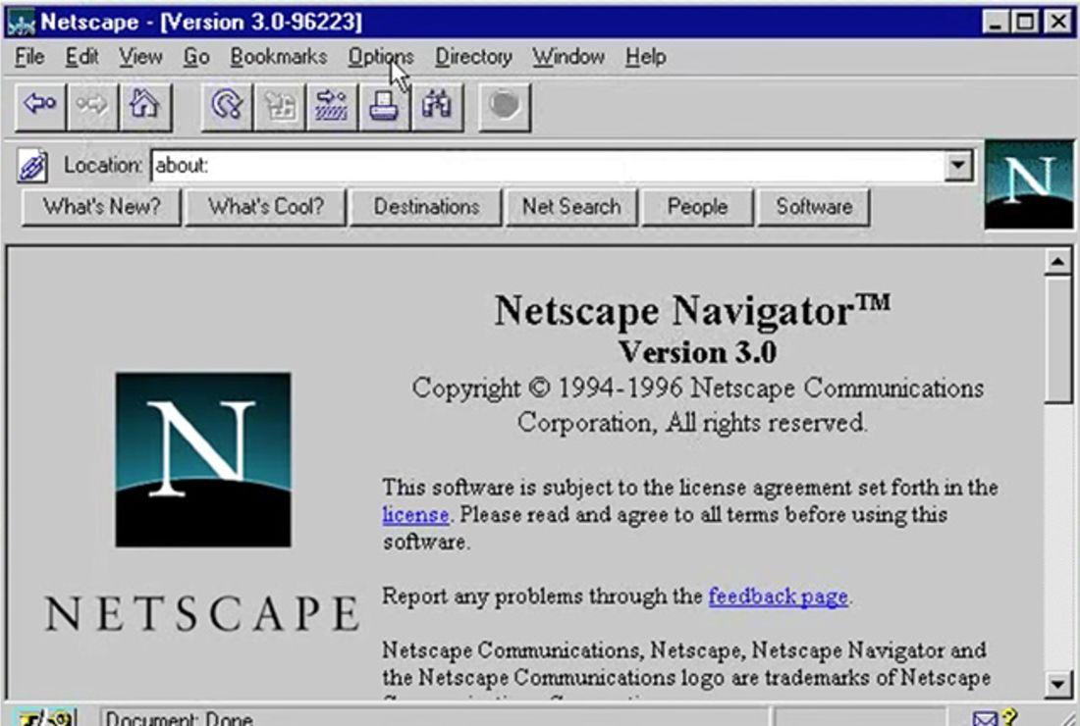
History
JavaScript created by Netscape
Standardized by European Computer Manufacturers Association (ECMA)
http://www.ecma-international. org/publications /standards/Ecma-262.htm

Slide 3

What is JavaScript?
Created by Netscape - 1995
Originally called LiveWire then LiveScript
Developed by Brandon Eich
Named to make use of Java market buzz
IE and Netscape renderings are slightly different
JScript created by Microsoft vs JavaScript
Standardized today as ECMAScript
client-side scripting language
Client-side refers to the fact that it is executed in the client (software) that the viewer is using. In the case of JavaScript, the client is the browser.
A server-side language is one that runs on the Web server. Examples: PHP, Python
Interpreted on-the-fly by the client
Each line is processed as it loads in the browser

Slide 4
JavaScript is the most popular scripting language on the internet, and works in all major browsers, such as Internet Explorer, Mozilla, Firefox, Netscape, Opera.

Slide 5
WHAT IS JAVASCRIPT?
JavaScript was designed to add interactivity to HTML pages
JavaScript is a scripting language (a scripting language is a lightweight programming language)
A JavaScript consists of lines of executable computer code
A JavaScript is usually embedded directly into HTML pages
JavaScript is an interpreted language (means that scripts execute without preliminary compilation)
Everyone can use JavaScript without purchasing a license

Slide 6
Are Java and JavaScript the Same?
NO!
Java and JavaScript are two completely different languages in both concept and design!
Java (developed by Sun Microsystems) is a powerful and much more complex programming language - in the same category as C and C++.

Slide 7
How to Put a JavaScript Into an HTML Page?
<html>
<body>
<script type="text/javascript">
document.write("Hello World!")
</script>
</body>
</html>

Slide 8
Ending Statements With a Semicolon?
With traditional programming languages, like C++ and Java, each code statement has to end with a semicolon (;).
Many programmers continue this habit when writing JavaScript, but in general, semicolons are optional! However, semicolons are required if you want to put more than one statement on a single line.

Slide 9
What can a JavaScript Do?
JavaScript gives HTML designers a programming tool:
simple syntax
JavaScript can put dynamic text into an HTML page
JavaScript can react to events
JavaScript can read and write HTML elements
JavaScript can be used to validate data
JavaScript can be used to detect the visitor’s browser
JavaScript can be used to create cookies
Store and retrieve information on the visitor’s computer

